Slide 1
2019 Anoka County Bar Legislative Update
Bryan R. Lindberg
Assistant Anoka County Attorney
763-324-5386
bryan.lindberg@co.anoka.mn.us
Notes:
Adding a note

Slide 2
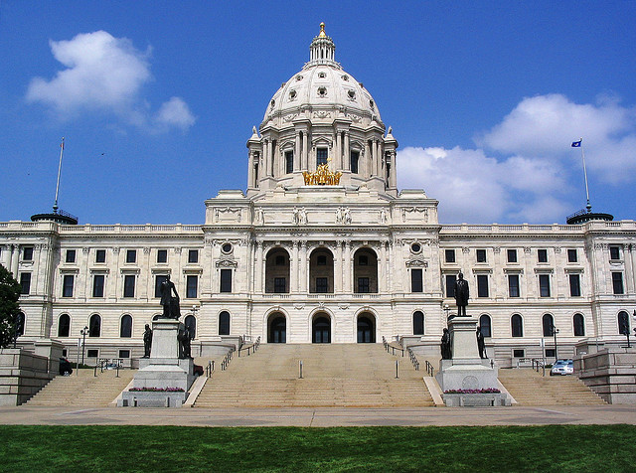

Slide 3
“Work Together”
Notes:
Close to 6000 bills introduced.

Slide 4
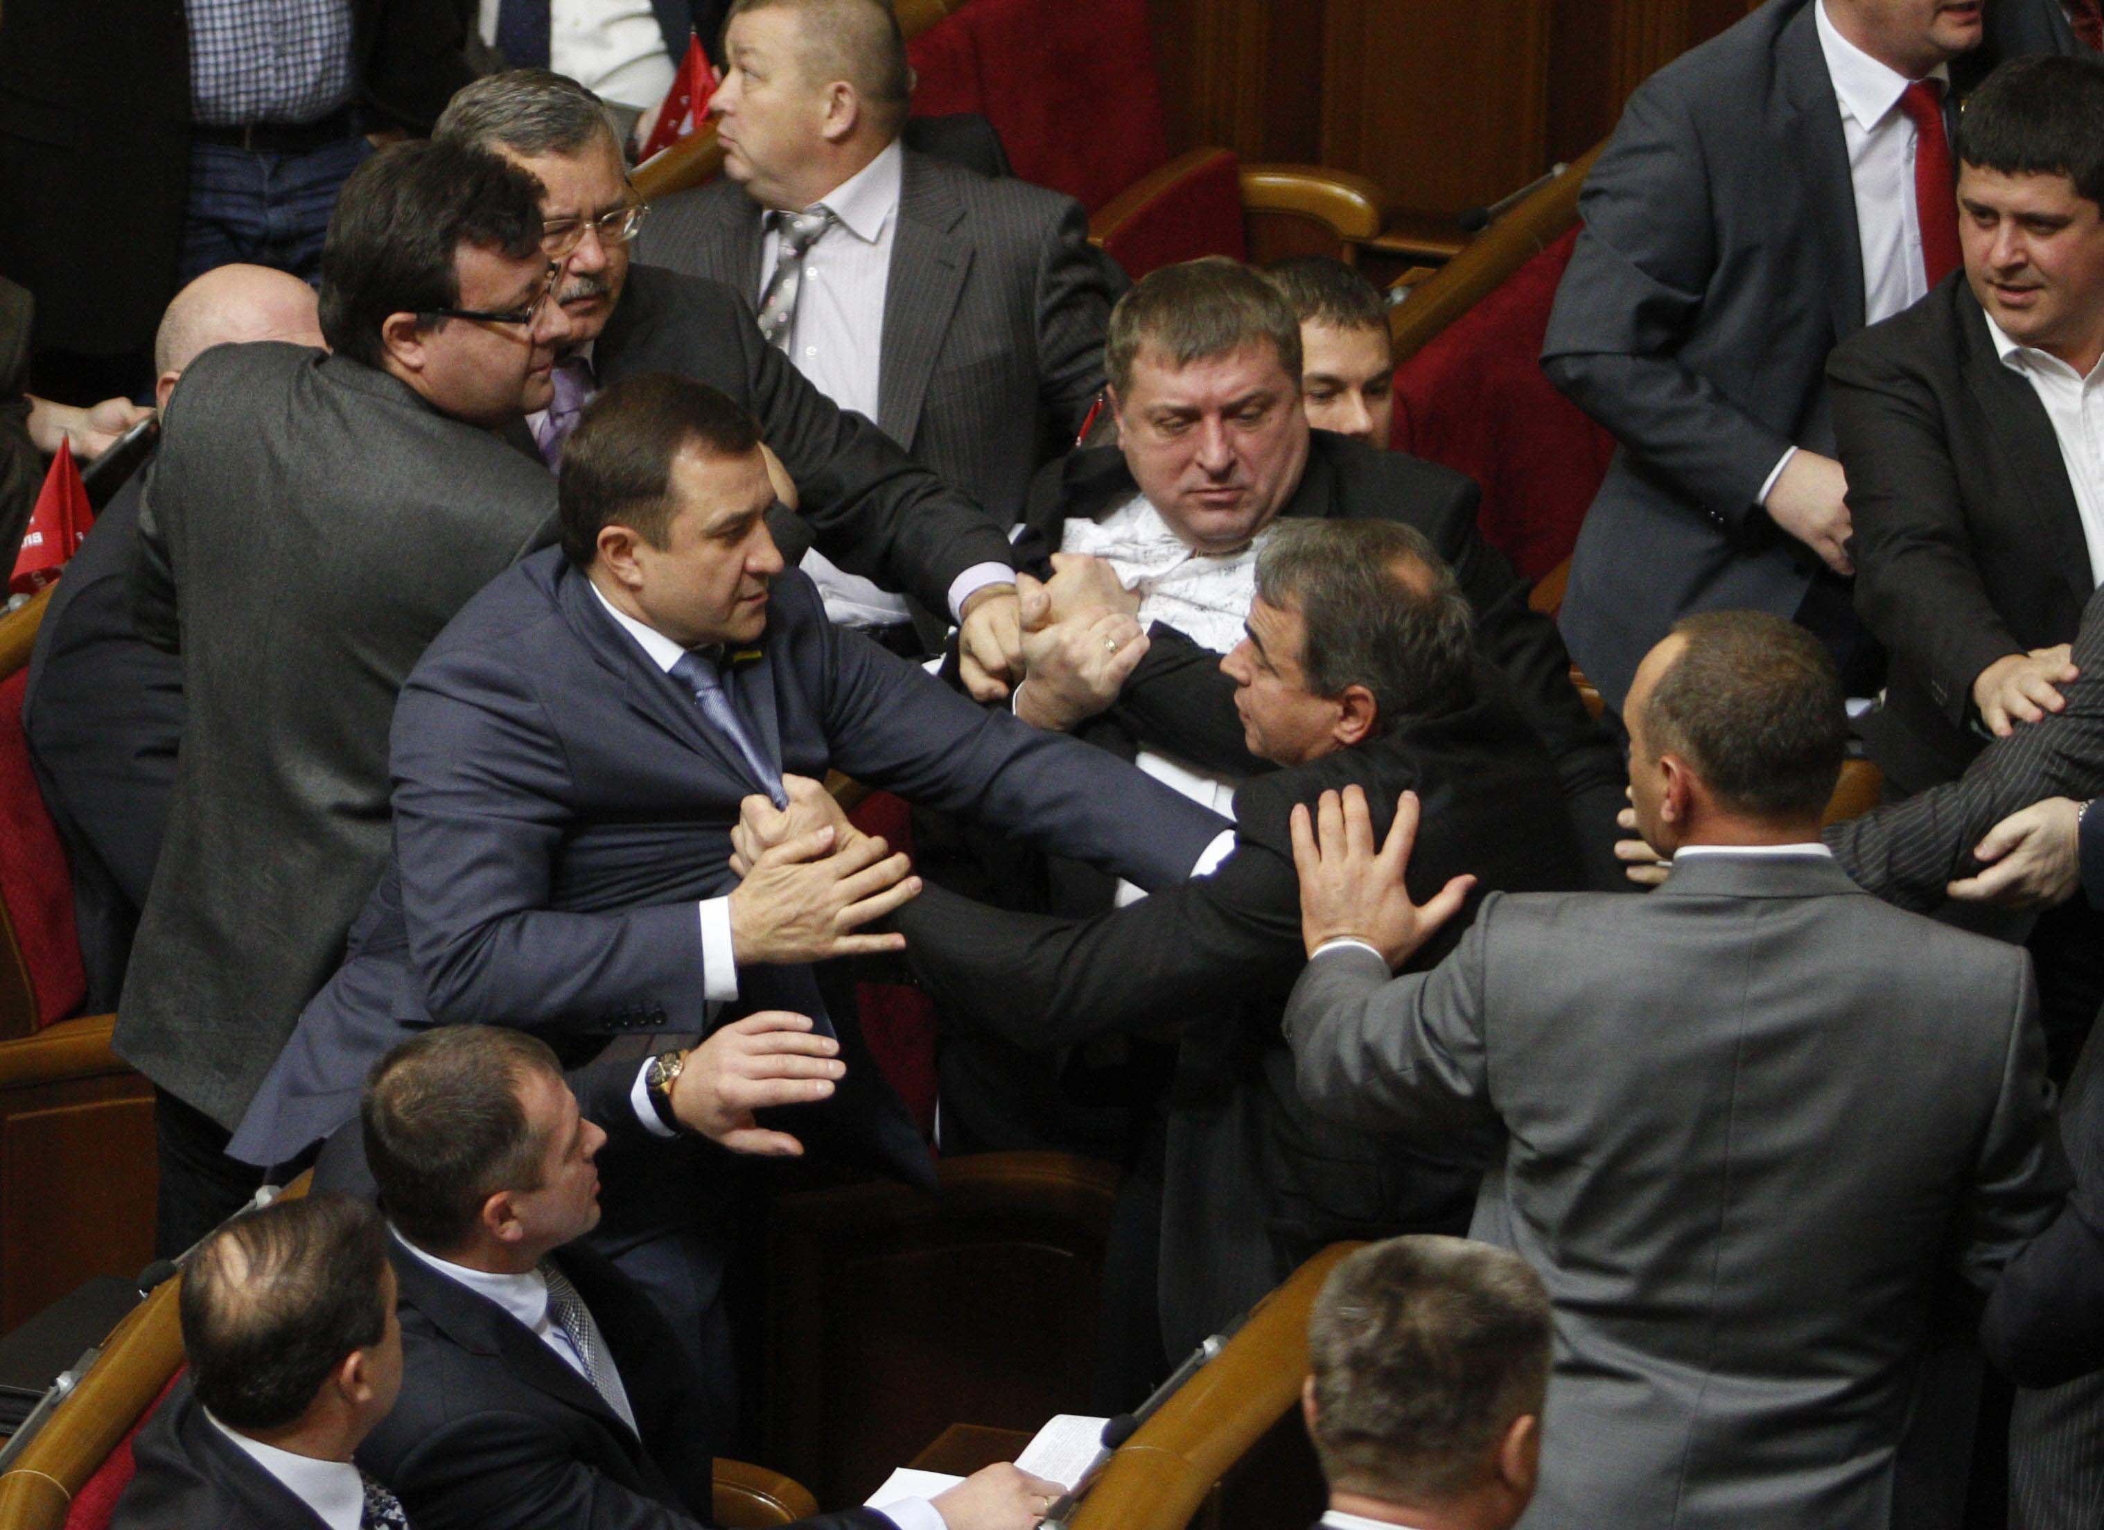

Slide 5
“Work Together”
Session begins – January 9, 2019
First bill presented to governor – March 5, 2019
78 bills signed into law
12 bills total in March and April
66 in May, including 13 during the special session
Notes:
Close to 6000 bills introduced.

Slide 6
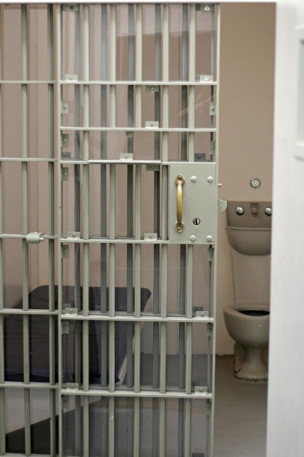
Criminal Law

Slide 8
Hidden Theft
Cost U.S. workers more than 8.6 billion dollars per year
2016 Wage Theft Prevention and Wage Recovery Act - HR 4763
More than 40,000 Minnesota workers pursue wage theft complaints each year
Minn. Dept of Labor and Industry - 2019

Slide 9
Notes:
Workers told to “clock out” and required to continue to work. Especially bad at closing time. Managers given goals and labor cost limits. Reducing labor costs to meet goals.

Slide 10
Wage Theft 609.52, subd. 1(14) – (15)
Employer –
Individual, partnership, association, corporation, business trust or any person or group of persons acting directly or indirectly in the interest of an employer in relation to an employee
Employee –
Any individual employed by an employer
Notes:
Must pay salaries or wages at least once a month and commissions once every three months. Recordkeeping requirements.

Slide 11
Wage Theft 609.52, subd. 1(13)
An employer, with intent to defraud
Fails to pay or fails to pay at a rate required by law all wages, salary, earnings, or commissions
Causes an employee to give a receipt for wages greater than that actually paid
Demands or receives a rebate or refund from wages
Makes or attempts to make it appear wages paid were greater than actually paid
Notes:
Must pay salaries or wages at least once a month and commissions once every three months. Does not include contractual arrangements other than employment contracts. New laws on when paid, how paid, recordkeeping, etc.

Slide 12
Wage Theft 609.52, subd. 2(19)
“Whoever commits wage theft”
Sentencing governed by 609.52, subd. 3
Theft over $35,000 – 20 year felony
Theft over $5,000 – 10 year felony
Theft over $1,000 – 5 year felony
Theft over $500 but not more than $1,000 – gross misdemeanor
Theft up to $500 – misdemeanor
Notes:
Must pay salaries or wages at least once a month and commissions once every three months

Slide 13
Wage Theft – Value 609.52, subd. 1(3)
For wage theft, “value” means the difference between wages legally required to be reported or paid to an employee and the amount actually reported or paid to the employee

Slide 14
Stalking

Slide 15
Stalking Harassment 609.749, subds. 1 - 4
What was once Stalking, is now Harassment
Gross misdemeanor levels
Felony Harassment
Race, color, religion, sexual orientation, etc.
Posses a weapon
Juror or judicial proceeding
Victim under 18 years of age

Slide 16
Pattern of Stalking 609.749, subd. 5
What was once Pattern of Stalking, is now just Stalking
Felony
Two or more acts within a 5-year period that violate a listed statute, and
Victim terrorized or feared bodily harm

Slide 18
Interference with Privacy 609.746, subd. 1
Prior law remains: Window peeping, installation or use of device, or peep in hotel, tanning booth or place of expectation of privacy
Gross misdemeanor
Two-year felony with prior conviction for
Interference with Privacy, or
Harassment

Slide 19
Interference with Privacy 609.746, subd. 1(f)
New four-year felony: Peeping by installation or use of device, or peep in hotel, tanning booth or place of expectation of privacy
Victim under 18 years of age
Perpetrator more than 36 months older than victim
Perpetrator knows or has reason to know minor victim is present, and
Committed with sexual intent

Slide 20
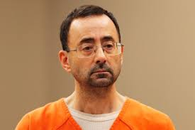
Notes:
175 years – federal and state

Slide 21
Position of Authority – 609.341, subd. 10
“Current or recent position of authority”
Includes anyone who “assumes” any of parent’s rights or duties or “assumes” duties for health, welfare, or supervision
Was in position of authority at the time of “or within 120 days immediately proceeding” the criminal act

Slide 22
Criminal Sexual Conduct in the First Degree - 609.342, subd. 1
For victims under the age of 13, crime included both penetration and contact
Certain provisions of the statute limited to “sexual penetration” scenarios
Now, the criminal act includes either penetration or contact

Slide 23
Peace Officer Criminal Sexual Conduct
Criminal Sexual Conduct in the Third Degree and Fourth Degree
Penetration or contact
Actor is a peace officer
Officer physically or constructively restrains the victim, or
Victim does not feel free to leave the officer’s presence
Notes:
Corrections officers, massage therapists, special transportation drivers, psychotherapists

Slide 24
Peace Officer Crim Sex – cont’d
Consent by the victim is not a defense
Charge does not apply to any penetration of the mouth, genitals, or anus during a lawful search
Statute does not differentiate between “on duty” and “off duty”

Slide 25
Criminal Sexual Conduct in the Fifth Degree

Slide 26
Crim Sex Fifth Degree – 609.3451
“. . . but does not include the intentional touching of the clothing covering the immediate area of the buttocks . . .”

Slide 27
Stay of Adjudications – 609.095(b)
A stay of adjudication on any criminal sexual conduct conviction or failure to register as a predatory offender conviction
Must be “justified” in writing and on the record

Slide 29
Marital Rape Exception – 609.349
Absolute defense to many provisions of Criminal Sexual Conduct 1st through 4th Degrees
“Does not commit”
Cohabitating adults in voluntary relationship
Legal spouse
Repealed
Notes:
Senator Michelle Benson – co-author. Anoka County victim wife, while in the process of a divorce, discovered a videos where she was drugged and raped by husband. Ultimately pled to Invasion of Privacy.

Slide 31
Sexual Assault Reporting 609.3459
A victim of criminal sexual conduct may make report to any law enforcement agency regardless of where the crime occurred
The agency receiving the report must initiate an investigation of the facts
The receiving agency must refer the matter to the appropriate jurisdiction along with a summary of the investigation

Slide 32
Sexual Assault Reporting cont’d
If report is referred to another law enforcement agency, it will not need to be included in crime statistics for the referring agency
The referring agency must confirm the referral to the appropriate jurisdiction investigation

Slide 34
Predatory Offender Registration 243.166
Law enforcement shall notify defendant of the need to register if not done by the court or corrections agent
Registration includes DNA sample and fingerprints
Registration information includes all telephone numbers – work, school, home, and cell phone
Vehicle license plate tab expiration year
Notes:
Law enforcement means “Sheriff”

Slide 35
Predatory Offender Registration 243.166
Interference with Privacy (Surreptitious Intrusion) – 609.746, subd. 1(f), added to list
Now all listed offenses requiring registration include attempts, aid and abet, or conspiracy and any other offense arising out of the same set of circumstances

Slide 36
Predatory Offender Registration cont’d
Criminal violation if:
Defendant was given notice
Knows, or reasonably should know, of duty to register
Knowingly commits an act or fails to fulfill a registration requirement that violates the registration provisions
Notes:
Clarification of criminal elements. Previously, “violates a provision of the registration section”

Slide 37
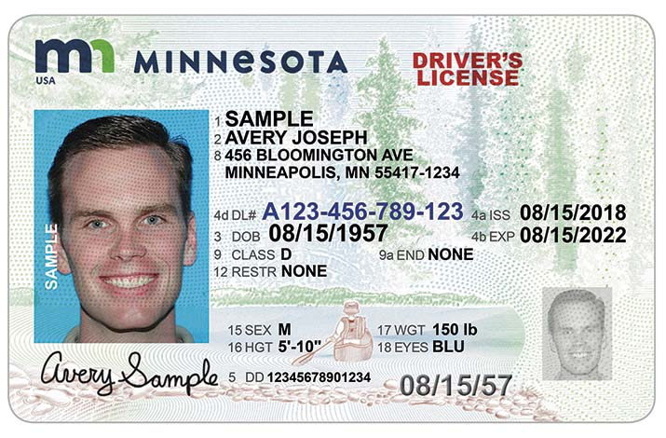

Slide 38
Predatory Offender Driver’s License Photo 171.07, subd. 1a
Criminal justice agencies may access driver’s license photo of predatory offenders to assist in locating those required to register
Previously private data

Slide 39
Evidence of Conduct – 634.20

Slide 40
Evidence of Conduct – 634.20
Evidence of domestic conduct by the accused against the victim admissible at trial
“Domestic conduct” amended to include Violation of Domestic Abuse No Contact Order

Slide 42
Opioid Limit 152.11
No prescription for opiate or narcotic pain reliever may be initially dispensed for more than 30 days
No prescription refill may be dispensed for more than 30 days
When refills expire, so does prescription
New prescription required for extended prescription therapy
Notes:
No penalty provided. Default to a petty misdemeanor, but may set up civil suit.

Slide 43
Traffic and Vehicle Laws

Slide 45
First Degree DWI – Priors 169A.24, subd. 1(3)(iv)
First Degree enhancement currently includes prior Minnesota felony DWI conviction or felony Criminal Vehicular Operation (drugs or alcohol related) conviction
New law includes out of state felony Criminal Vehicular Operation (drugs or alcohol related) convictions

Slide 46
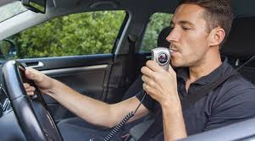

Slide 47
Interlock and Forfeiture 169A.63, subd. 13
If drinking driver becomes a participant in an ignition interlock program, vehicle must be returned to driver, and
Forfeiture proceedings are stayed

Slide 48
Interlock and Forfeiture cont’d
Vehicle may be seized and the forfeiture proceedings continue if:
Driver subsequently operates a motor vehicle and:
Commits a DUI or DUI-related offense
Bypasses or tampers with interlock
Drives without interlock

Slide 49
Interlock and Forfeiture cont’d
Vehicle may be seized and the forfeiture proceedings continue if:
Driver fails to participate in interlock program for more than 30 days
Driver fails to successfully complete the program
Applies to conduct occurring before driving privileges are restored or 3 years from offense date, whichever occurs latest

Slide 50
Interlock and Forfeiture cont’d
Driver may be required to pay towing, seizure, and storage costs
Driver may be required to give security or post a bond equal to the value of the seized vehicle
Forfeiture proceedings against security or bond, not vehicle, if posted

Slide 51
Interlock and Forfeiture cont’d
If driver successfully completes the interlock program, forfeiture proceedings dismissed
If driver fails the interlock program, may still contest forfeiture

Slide 52
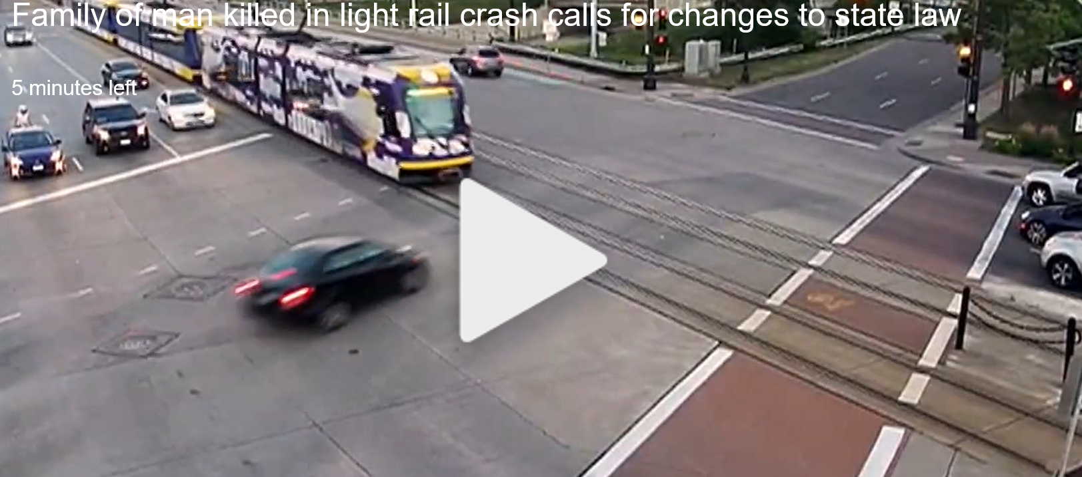
Notes:
July 15, 2017. Light rail driver runs a stop signal on University Avenue in St. Paul killing the driver of the vehicle, Nicholas Westlake, and seriously injuring the passenger. No criminal charges against the light rail driver because the traffic code did not apply to the operation of a rail train. Light rail driver was not speeding, not on his phone, and sounded his horn per procedure.

Slide 53
Reckless/Careless Driving 169.13, subds. 1 and 2
Reckless: A person who drives a motor vehicle or light rail transit vehicle while aware of and consciously disregarding a substantial and unjustifiable risk that the driving may result in harm to another or another’s property
Misdemeanor
Gross misdemeanor, if result is great bodily harm or death

Slide 54
Reckless/Careless Driving 169.13, subds. 1 and 2
Careless:
Any person who operates or halts a light rail transit vehicle carelessly or heedlessly in disregard of the rights of others, or
In a manner that endangers or is likely to endanger any property or any person, including the operator or passengers on the light rail transit vehicle
Misdemeanor
Notes:
Mirrors the language of careless driving, but specifically includes light rail. An easier solution may have been to include a light rail vehicle in the definition of a “motor vehicle”

Slide 55
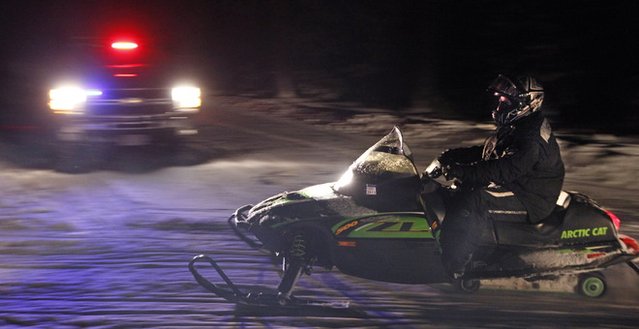

Slide 56
Snowmobile and ATV Riding Privileges – 84.91
Snowmobilers and ATV riders operating privileges revoked for one year
Previous: For test refusal for any violation under 169A.20, or
New: Test failure

Slide 58
Boating Privileges – 86B.331
Boat operating privileges revoked
Previous: 90 days (May 1 to October 31) for test failure for any 169A.20 violation, or
New: One year for test refusal

Slide 59
Notes:
Lots of media on this of late. Many injuries and close calls. Minnesota school bus drivers report more than 600 stop-arm violations per day.

Slide 60
Yield to School Bus 169.20, subd. 7
Right-hand lane traffic must yield to a school bus attempting to enter traffic lane
School bus stopped to load or unload passengers
School bus must indicate intent by activating flashing left turn signal

Slide 62
Flagger 169.06, subd. 4a
Flaggers may stop and hold vehicles and direct vehicles to proceed when it is safe
A peace officer may issue a citation for a violation upon receiving report from a qualified flagger with:
Vehicle description and license plate
Time of incident
Description of driver
Report made by flagger within four hours of incident

Slide 63
Flagger cont’d
“Qualified” flagger has completed training including:
Flagging operations
Equipment
Traffic laws
Observation and accurate identification of motor vehicles

Slide 64
Flagger cont’d
Citation may be issued by a peace officer even though the violation did not occur in the officer’s presence if previously listed criteria are all met

Slide 66
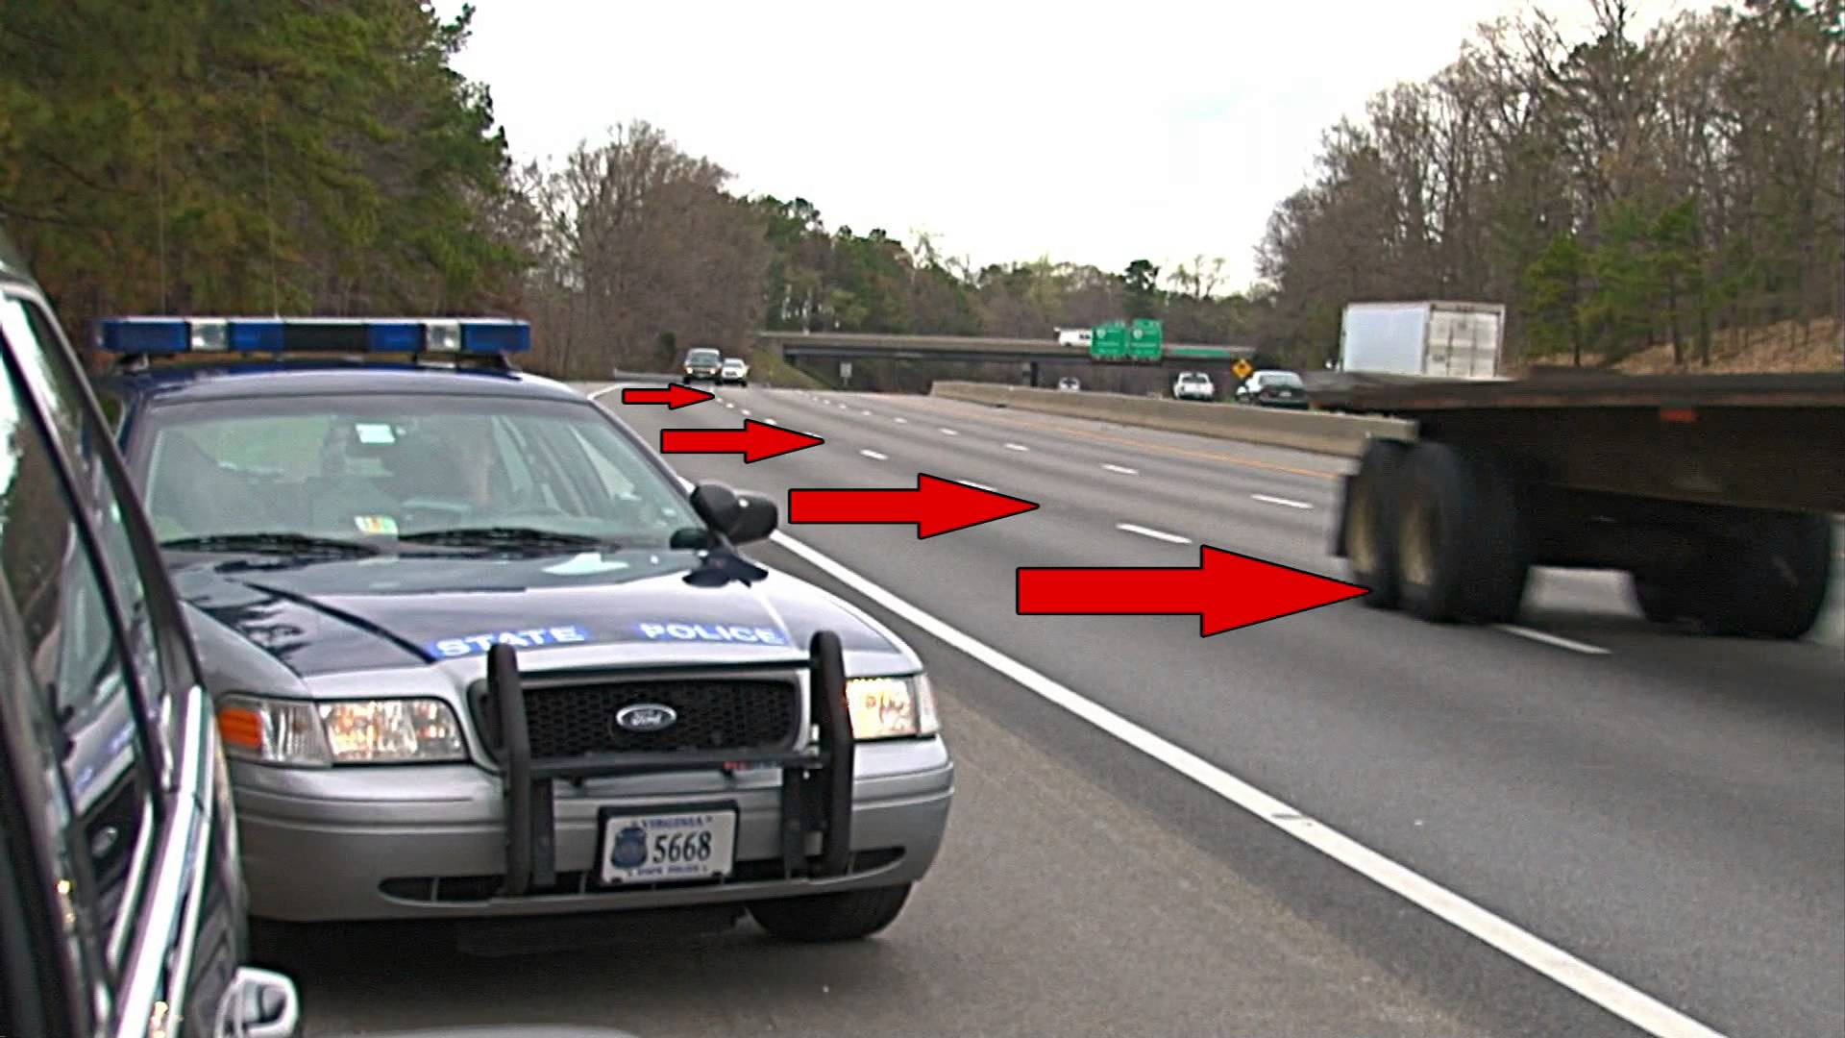

Slide 67
Parked Emergency Vehicle 169.18, subd. 11
Emergency amended to “Authorized”
“Authorized” vehicle expanded to include vehicles beyond previous emergency vehicles
Police
Fire
Rescue
Ambulance

Slide 68
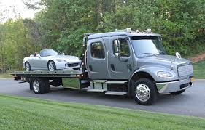

Slide 69
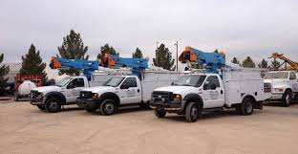

Slide 71
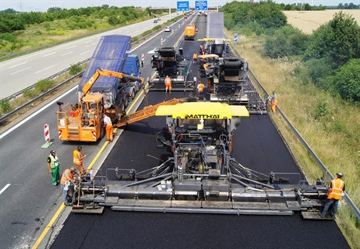

Slide 72
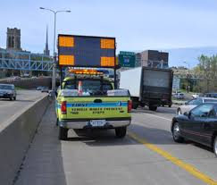

Slide 74
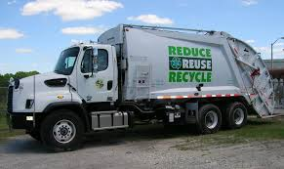

Slide 75
Authorized Vehicles cont’d
Parked or stopped next to street or highway with emergency flashing or warning lights activated

Slide 76
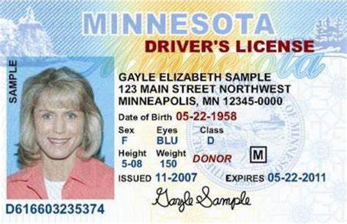

Slide 77
Driver’s License Misc
Drivers with mental health issues or autism spectrum disorder may request driver’s license with identifying symbol on the license (171.07)
Upon written request by the driver, the state can maintain emergency contact information for up to 3 contacts (171.12)
Notes:
Assumes completion of new MNLARS system

Slide 79
Hands Free 169.475
Applies when
Vehicle is upon a street or highway
Vehicle is in motion, or
Part of traffic

Slide 80
Hands Free Prohibitions
You cannot
Initiate, compose, send, retrieve or read an electronic message
Engage in a cellular call, including talking or listening or video calling
Access video content, audio content, images, games or software applications (apps)

Slide 81
Hands Free Exceptions
You can, when solely in voice-activated or hands free mode, while in motion or part of traffic
Initiate, compose, send, retrieve, or listen to an electronic message
Participate in a cellular phone call

Slide 82
Hands Free Exceptions
You can, while in voice-activated or hands-free mode
Use a GPS system, if no typing is required to operate GPS
Device is not held with one or both hands

Slide 83
Hands Free Exceptions
Hands-free or voice-activated exception does not apply to
Accessing video content
Video calling
Live-streaming
Accessing gaming data, or
Reading electronic messages

Slide 84
Hands Free Emergency Exceptions
You can
Hold your device to obtain emergency assistance
To report a traffic accident
To report a medical emergency
To report a traffic hazard, or
To prevent a crime about to be committed

Slide 85
Hands Free Emergency Exceptions
You can
Hold your device in the reasonable belief that a person’s life or safety is immediate danger
Hold your device in an authorized emergency vehicle while in the performance of official duties

Slide 86
Hands Free Definitions
“Voice-activated or hands-free” means an attachment, accessory, wirelessly paired or tethered capability, application, wireless connection, or built-in feature of a wireless communication device or a motor vehicle that allows the person to use verbal or single touch commands
Does not include typing or scrolling

Slide 87
Hands Free Definitions
A vehicle is not “in motion” or “part of traffic” when
Lawfully stopped
Stop location that is not designed for or ordinarily used for vehicular travel, and
Stopped vehicle is not obstructing traffic

Slide 88
Hands Free Does Not Apply
Citizen band radios
Two-way radios
Amateur radios (FCC compliant)
Data transmitted without initiation by any person

Slide 89
Hands Free Penalty
First time - $50 (plus law library fee and state surcharges)
Each subsequent - $275 (plus law library fee and state surcharges)

Slide 91
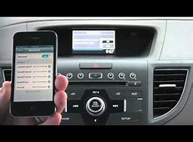

Slide 92
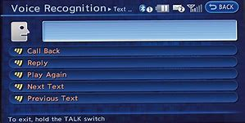

Slide 93
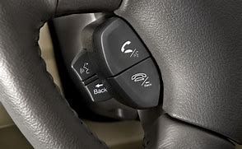

Slide 94
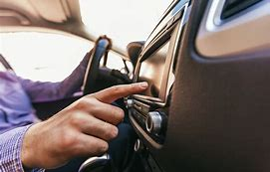

Slide 95
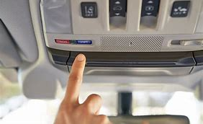

Slide 96
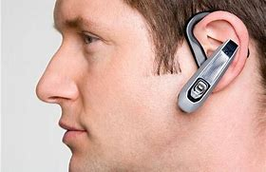

Slide 99
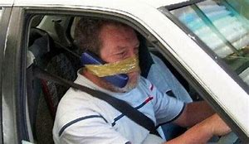

Slide 100
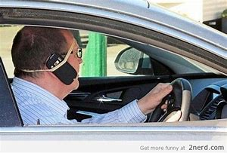

Slide 101
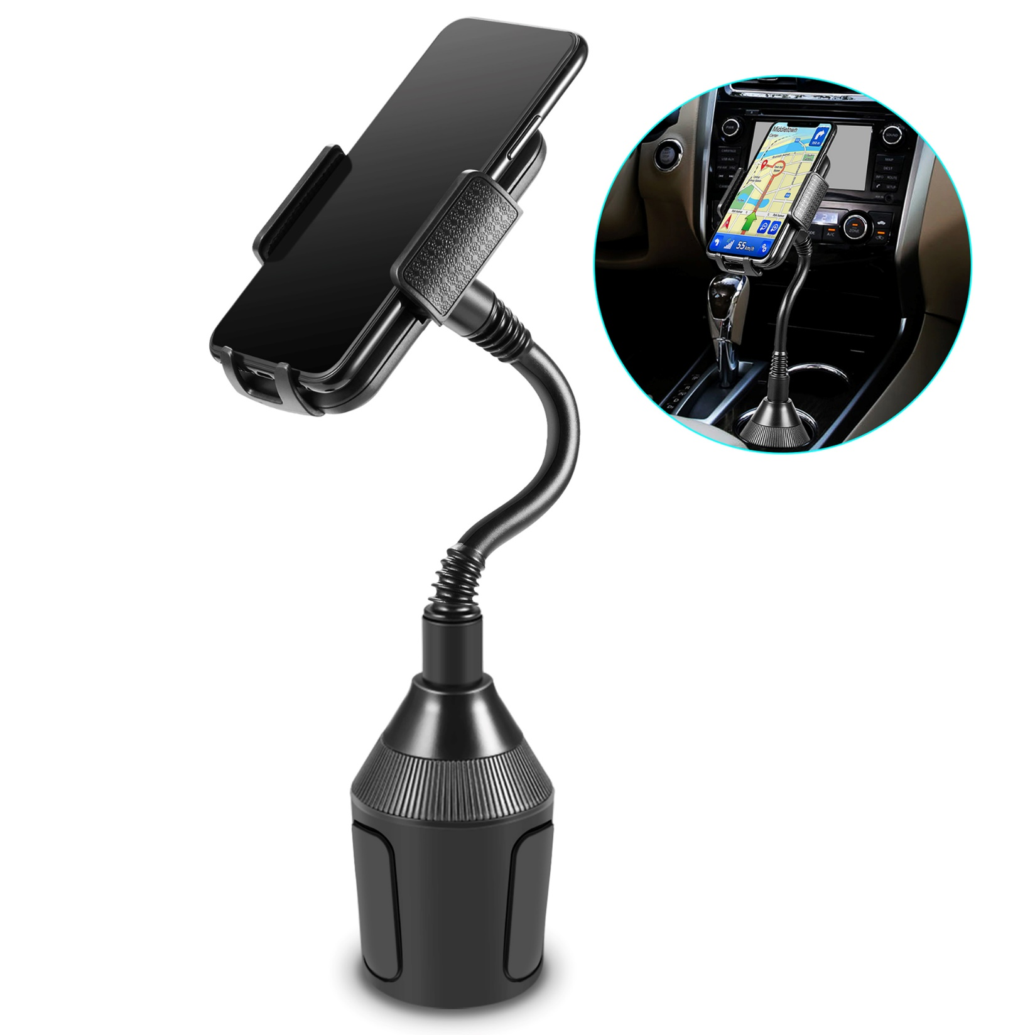

Slide 102
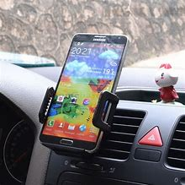

Slide 103
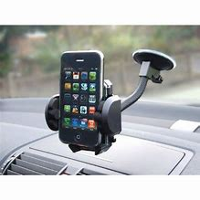

Slide 104
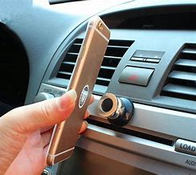

Slide 105
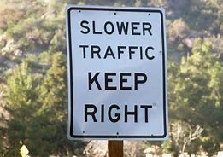

Slide 108
Slowpoke Law 169.18, subd. 10
Upon a roadway with one lane
A person proceeding at less than the normal speed of traffic at the time and place and under conditions then existing a speed that is sufficiently low as to create a traffic hazard must operate the vehicle as close as practicable to the right-hand curb or edge of roadway

Slide 109
Slowpoke Law cont’d
Upon a roadway with more than one lane
A person must move from the left-most lane to allow another vehicle to pass, when practicable under the existing conditions
Notes:
Vehicle overtaking the other must not speed, or so they say. 35 – left lane vehicles passing cars in the right lane and string of cars on left lane vehicle’s bumper who want to go even faster.

Slide 110
Slowpoke Law cont’d
It does not apply to
Left-lane exits
Preparing for left turns at intersections
“Slow” vehicle is passing another vehicle
Vehicle designated to left-lane
Emergency vehicles
Notes:
Vehicle overtaking the other must not speed, or so they say. 35 – left lane vehicles passing cars in the right lane and string of cars on left lane vehicle’s bumper who want to go even faster.

Slide 111
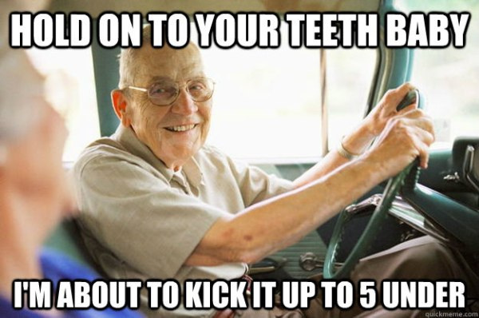

Slide 112
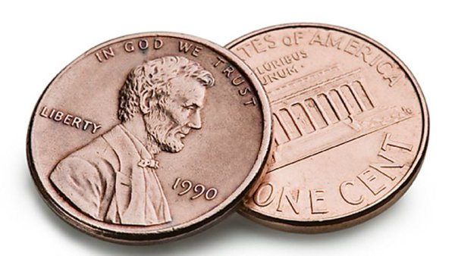

Slide 113
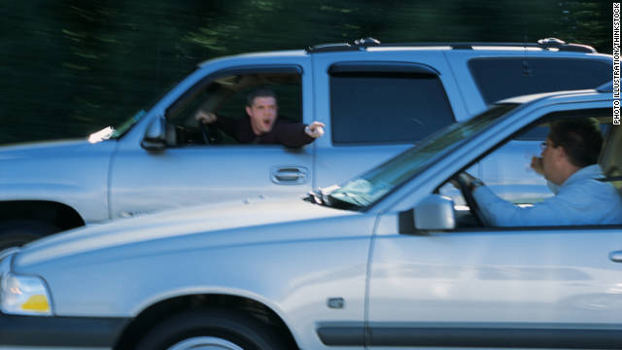

Slide 115
Slowpoke Law Scenario
Two vehicles in left and right lanes going 65 miles per hour in a 65 mile per hour zone. String of cars behind in left lane all tailgating one another.
Does the vehicle in the left-hand lane proceeding at (or in excess of) the speed limit have an obligation to move over?
Notes:
Law enforcement would be saying is if you are in the left-hand lane, we want you to speed.

Slide 116
Slowpoke Law
Upon a roadway with more than one lane a person must move from the left-most lane to allow another vehicle to pass, when practicable under the existing conditions
Vehicle in left-hand lane is allowed to stay in left-hand lane when passing other vehicles
Notes:
Vehicle overtaking the other must not speed, or so they say. 35 – left lane vehicles passing cars in the right lane and string of cars on left lane vehicle’s bumper who want to go even faster.

Slide 117
Slowpoke Law
State has codified “absolute” speed limits - Minn. Stat. 169.14, subd. 2
Posted limit not to be exceeded
Exception: You may exceed the speed limit by up to 10 miles per hour when passing on a designated (55 mph or higher) two-lane highway - Minn. Stat. 169.14, subd. 2a
Notes:
Why are you giving me a ticket when I was doing the speed limit and the vehicle behind me is speeding?

Slide 118
Slowpoke Law
State Patrol – “ . . . we’re definitely focused on speeding . . . “
State Patrol – “ . . . that person holding up traffic in the left lane can cause problems, can cause frustration, can lead to aggressive driving, but it is not the contributor to fatal and injury crashes [at the level seen from excessive speed] . . .”

Slide 119
Thank you

Slide 120
A
Tony Palumbo
Production

