Slide 1
2022 Anoka County Bar Association Legislative Update
Bryan R. Lindberg
Assistant Anoka County Attorney
763-324-5386
bryan.lindberg@co.anoka.mn.us
Notes:
Adding a note

Slide 2
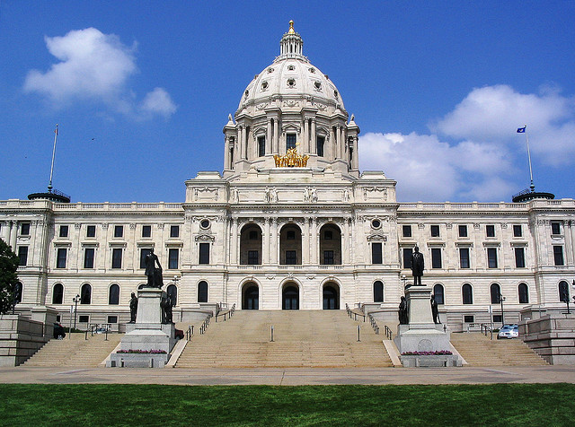

Slide 3
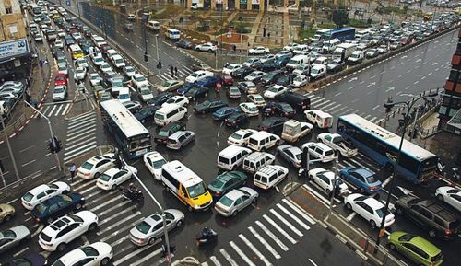
Notes:
The regular session yielded the fewest number of new chapters in one regular session in history. Since 1858.

Slide 4
Notes:
9.25 billion dollar – that is billion with a “B” – surplus. $4 tax breaks - $4 new spending - $4 left over in case economy worsens.

Slide 6
Edibles
“Edible cannabinoid product”
Any product, that is not a drug, that is intended to be eaten or consumed as a beverage by humans that contains a cannabinoid in combination with food ingredients
Minn. Stat. 151.72, subd. 1(c)
Notes:
Found in the Health and Human Services policy bill. Amends the Pharmacy Practice Act.

Slide 7
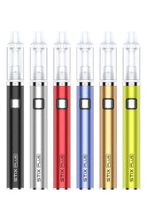

Slide 8
Edibles – cont’d
To be legal, the edible cannabinoid product:
Cannot contain more than 0.3 percent THC
Cannot exceed more that 5 milligrams of THC in a single serving
Cannot exceed more than 50 milligrams of THC per package

Slide 9
Edibles – cont’d
Can contain previously prohibited Delta-9 THC, that does not exceed thresholds
Removed from Schedule I list of controlled substances and are not controlled substances
Minn. Stat. 151.72, subd. 3(d)

Slide 10
Edibles – cont’d
Packaging cannot bear the likeness or contain cartoon-like characteristics of a real or fictional person, animal, or fruit that appeals to children
Notes:
Brussel sprouts? Picture of Ann Margaret or Elizabeth Taylor or Rock Hudson?

Slide 11
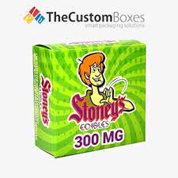

Slide 12
Edibles – cont’d
Packaging cannot be modeled after a brand of products primarily consumed by children
Notes:
Brussel sprouts? Picture of Ann Margaret or Elizabeth Taylor or Rock Hudson?

Slide 13
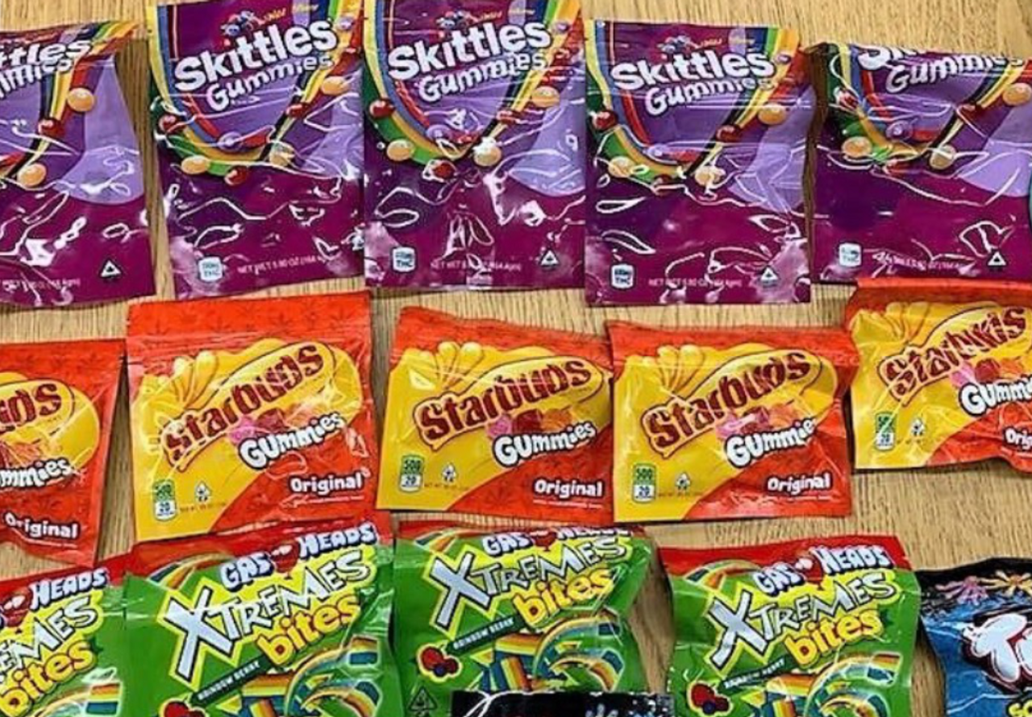

Slide 14
Edibles – cont’d
Cannot be packaged in a way that resembles commercially available food product

Slide 16
Edibles – cont’d
Cannot be packaged in a container that includes statement, artwork, or design that could reasonably mislead any person to believe that it contains anything other than an edible cannabinoid product

Slide 17
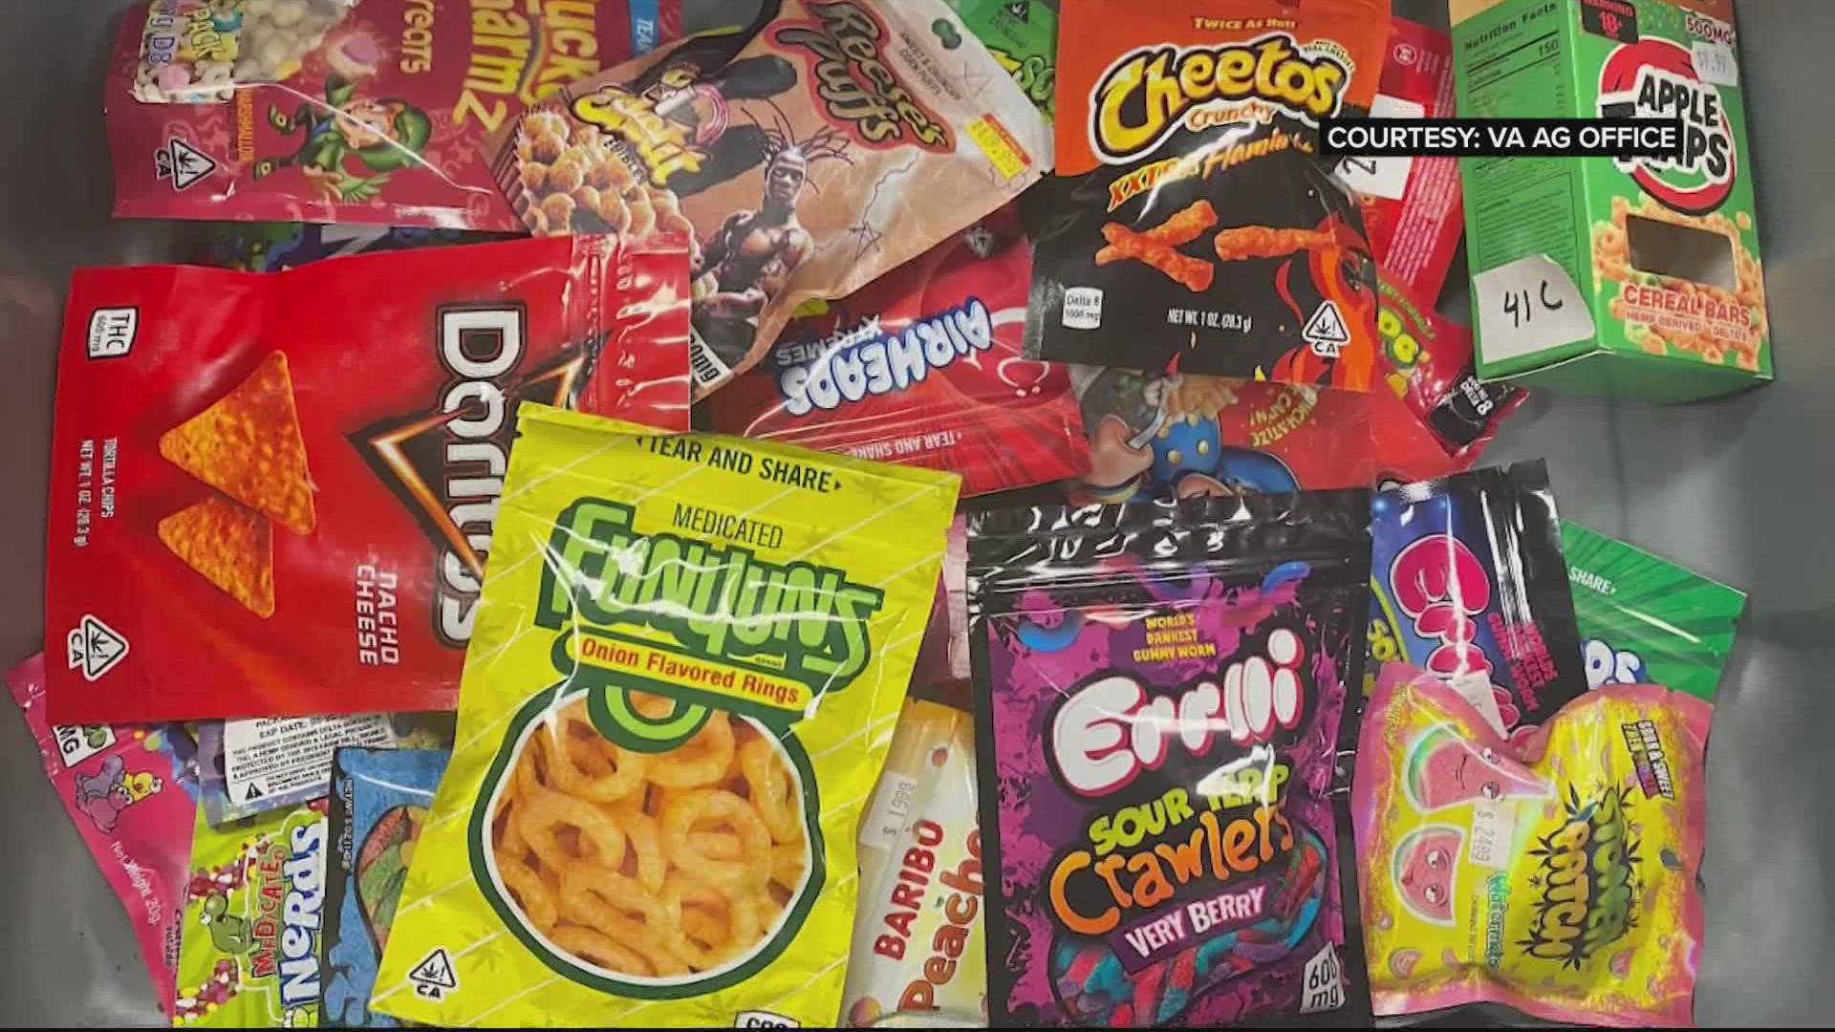
Notes:
Might not know it, until you have to pay for it.

Slide 18
Edibles – cont’d
Packaging must be child-resistant, tamper-evident, and opaque
Single serving size defined by wrapping or scoring
On the packaging, the individual serving size cannabinoid product amount and total cannabinoid product amount must be listed
Notes:
Tylenol. Tamper-evident.

Slide 21
Edibles Enforcement
Sale to persons under the age of 21 illegal
Minn. Stat. 151.72, subd. 3(c)
Any product exceeding .03 % THC, more than 5 milligrams THC per serving, or more than 50 milligrams THC per package is considered to be an “adulterated drug”
Minn. Stat. 151.72, subd. 6
Sell or deliver adulterated drug unlawful
Minn. Stat. 151.34

Slide 22
Edibles Issues
No licensing provisions
No funding sources for enforcement
Moratoriums on sales by cities
Sale location restrictions
St. Cloud Planning Commission zoning
Tax revenue losses of up to $46 million per year (assuming 10% tax rate)
Notes:
Quarter of a mile from a park, church, or school

Slide 23
Edibles Issues
Traditional lab testing of the product not practical
“Mixture” vs. percentage and specific amount in each serving size or package
Notes:
Quarter of a mile from a park, church, or school

Slide 25
Structured Settlements Minn. Stat. 549.30 – 549.41
Structured settlements from civil lawsuits, insurance claims, worker’s compensation payments, or other damage awards
Prior to the transfer of a structured settlement and a lump-sum payment being made, new requirements for the transferee

Slide 26
Structured Settlements – cont’d
Disclosure statement to payee
Aggregate amount of payments
Gross advance amount
Itemized list of all transfer expenses
Effective annual interest rate that payee will be paying to transferee

Slide 27
Structured Settlements – cont’d
Transferee must be registered to do business in Minnesota
Must post surety bond, cash, or letter of credit
Transfer must be approved by the court
Transfer must be in the “best interests” of the payee, taking into account the welfare and support of the payee’s dependents

Slide 28
Structured Settlements – cont’d
Payee must be advised in writing to seek independent professional advice regarding the legal, tax, and financial implications of the transfer
“Best interest” criteria include:
Payee’s mental capacity, maturity level
Other financial means without settlement payments
Payee’s financial obligations to dependents, including child support or maintenance

Slide 29
“Best Interests” – cont’d
Eligibility for future public benefits
Other relevant factors

Slide 30
Structured Settlements – cont’d
Court involvement:
Application for approval brought by transferee
In the county where payee is domiciled
“Timely” hearing
Court may appoint attorney to make an independent assessment and advise the court
Costs of attorney paid by transferee, not to exceed $2000

Slide 31
Structured Settlements – cont’d
Court shall appoint assessment attorney
Proposed transfer of minor’s structured settlement
If it appears to the court that payee may suffer from mental or cognitive impairment
Transferee must file a motion for appointment if the transferee is aware of mental or cognitive impairment

Slide 32
Structured Settlements – cont’d
No provision of the statute can be waived by payee

Slide 34
DNR Civil Penalties Minn. Stat. 84.775
Conservation Officers and Licensed Peace Officers
Issue civil citation
Off-highway motorcycle
Off-road vehicle
All-terrain vehicle
New - Snowmobile
Selected “trespass” violations of 84 or 97B

Slide 35
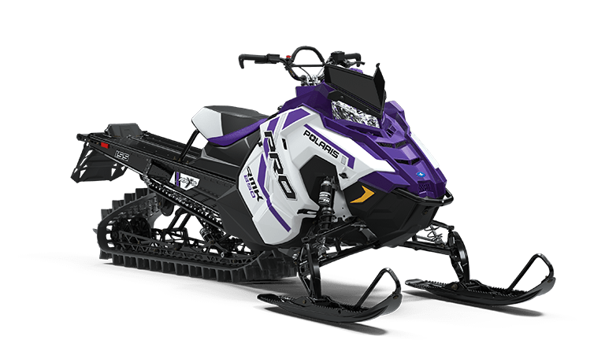
DNR Civil Penalties – cont’d
First offense - $250
Second offense - $500
Third or subsequent offense - $1000
Restitution required
Proceeds for trails and enforcement
Notes:
Double the monetary penalty for $500 = $100 up to $250 $200 up to $500

Slide 37
Organ Donor Minn. Stat. 72A.20
Insurance
Life, long term care, or disability
Cannot discriminate against living organ or bone marrow donor
Offerg, premium cost, issuance, cancellation, coverage amount, or other condition
Without additional actuarial risks

Slide 39
Safe At Home Minn. Stat. 5B.05 and 13.045
Protects location data upon filing of a notice
Real property records, including assessments, real property tax, personal property tax, and other data on real property
Landlords prohibited from displaying participant’s name at rental location
Notes:
Just go down the recorder’s office and see what I can find.

Slide 40
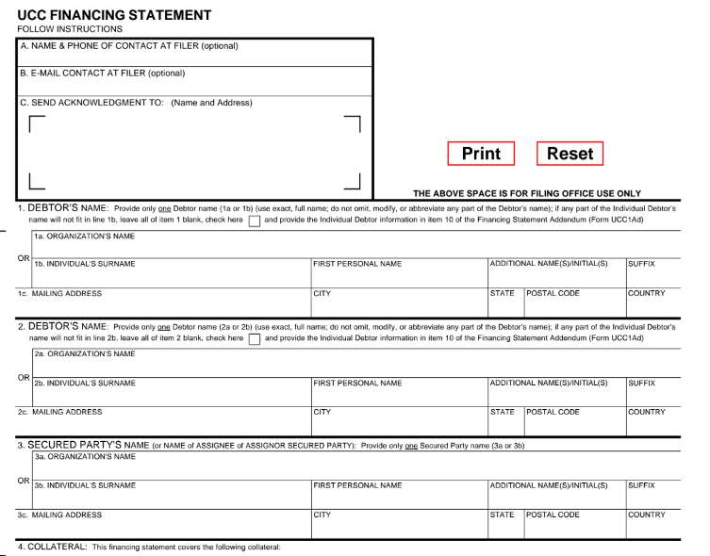

Slide 41
Lien Harassment Minn. Stat. 336.9-510
Secretary of State has the authority to administratively remove financing statement (lien)
Debtor files affidavit
No filing fee paid by debtor
Filed with intent to harass or defraud
Financing statement terminated
Mailed and e-mailed to secured party

Slide 42
Lien Harassment – cont’d
Secured party, may in good faith
Request expediated department review and removal of termination notice, or
File an action in district court within 6 months of the termination notice being filed
If successful, financial statement is reinstated
If affidavit for removal was not authorized and filed with intent to harass or defraud secured party, costs and expenses and attorney’s fees may be awarded
Notes:
Review on doc’s submitted by secured party

Slide 44
Canadian Judgments Minn. Stat. 548.64 - 74
Specific provisions for filing Canadian judgments
Registration procedure and effect
Notice provisions
Fully enforceable
Form provided by statute
Petition to vacate registration

Slide 45
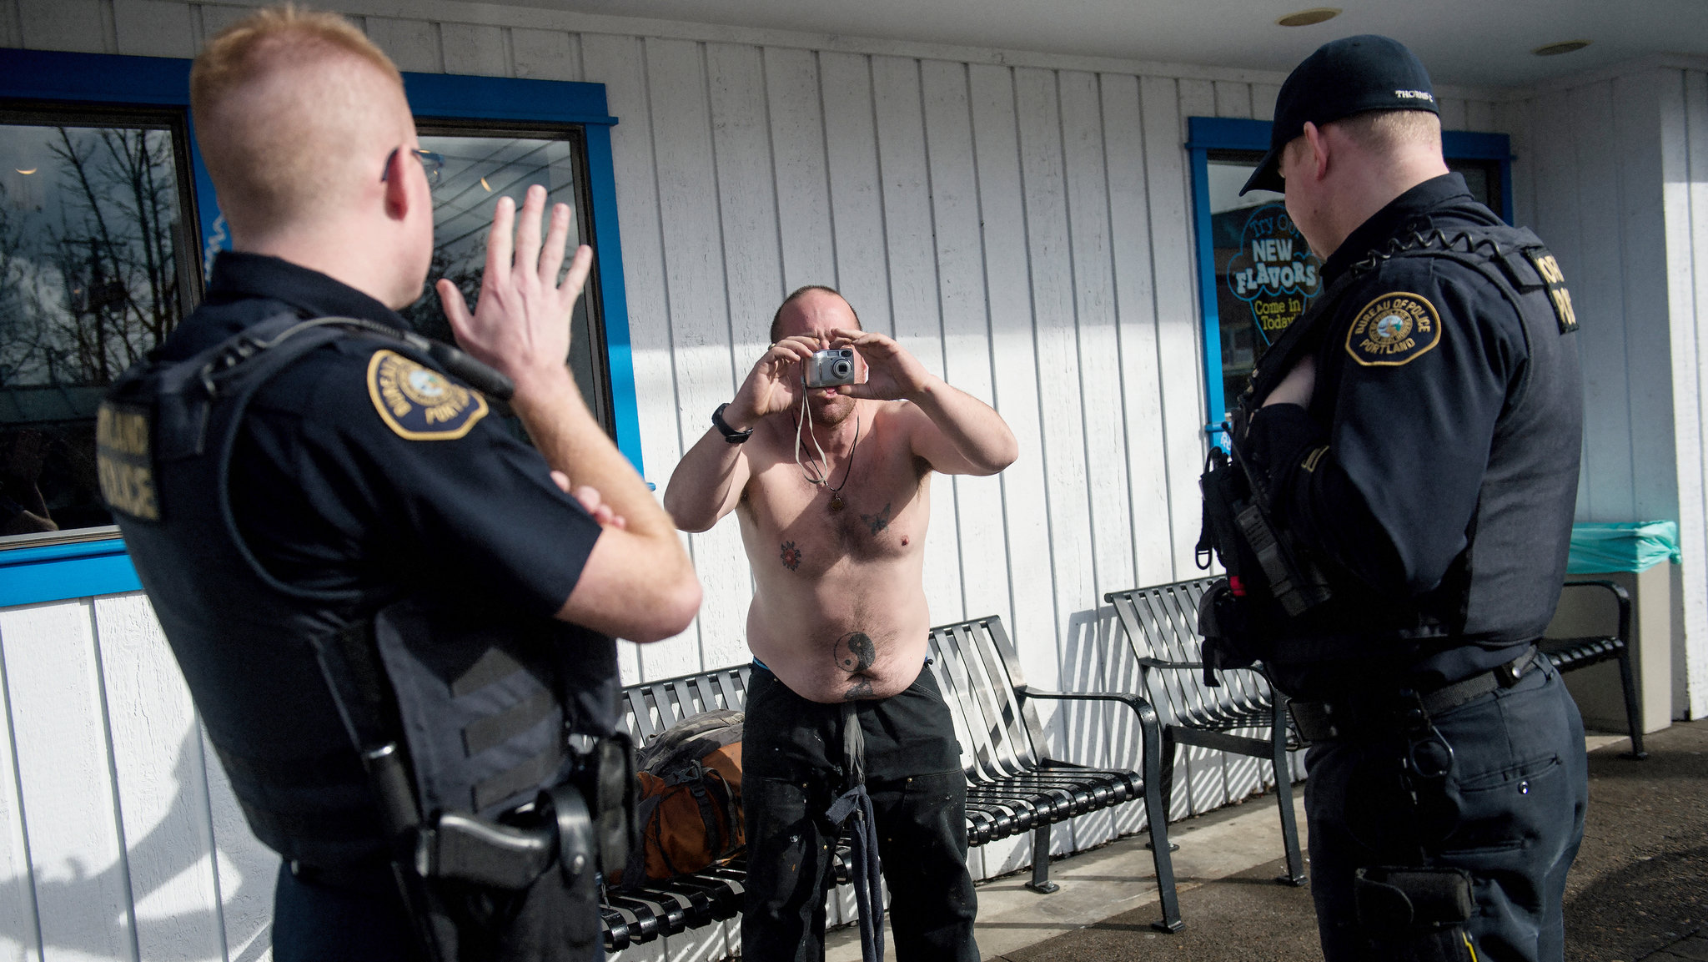

Slide 46
Mental Health Crisis Data Minn. Stat. 13.46
Allows sharing of protected mental health data with law enforcement during “mental health crisis”
Previous language was “emergency interaction”
Limited to allow for “safe response”
To include contact information of medical professionals and response strategies

Slide 47
Mental Health Crisis Data –cont’d
Chief law enforcement officer must develop written policy governing access, retention, and data security safeguards

Slide 49
Psychotherapist Minn. Stat. 609.341, subd. 17
“Psychotherapist” definition expanded to include “physician’s assistant”
Notes:
Physician, psychologist, social worker, chemical dependency counselor, marriage therapist, mental health service provider

Slide 51
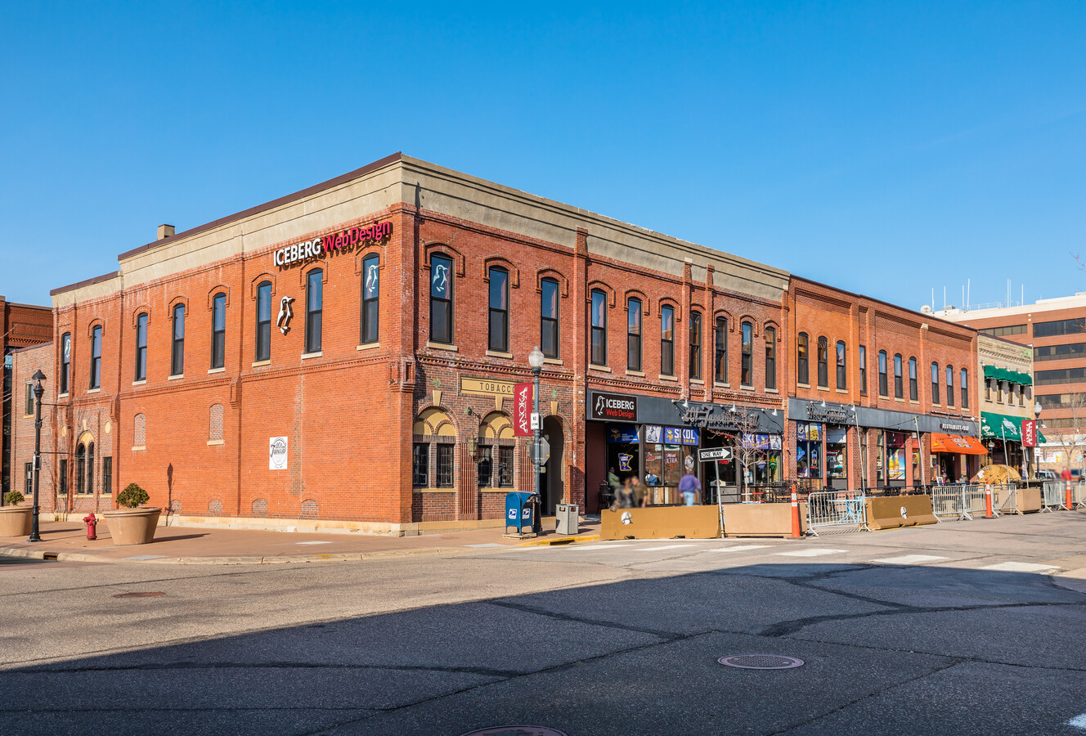

Slide 52
Anoka Social District Minn. Stat. 645.021
Allows consumption of alcoholic beverages within the boundaries of the social district
Beverages provided by on-sale establishments within the district
No glass containers
Social district logo and identifies seller
Establish boundaries and days and hours of consumption
Notes:
File a report after 24 months to the legislature – pros and cons, public response, safety concerns, rec’s for modifications

Slide 53
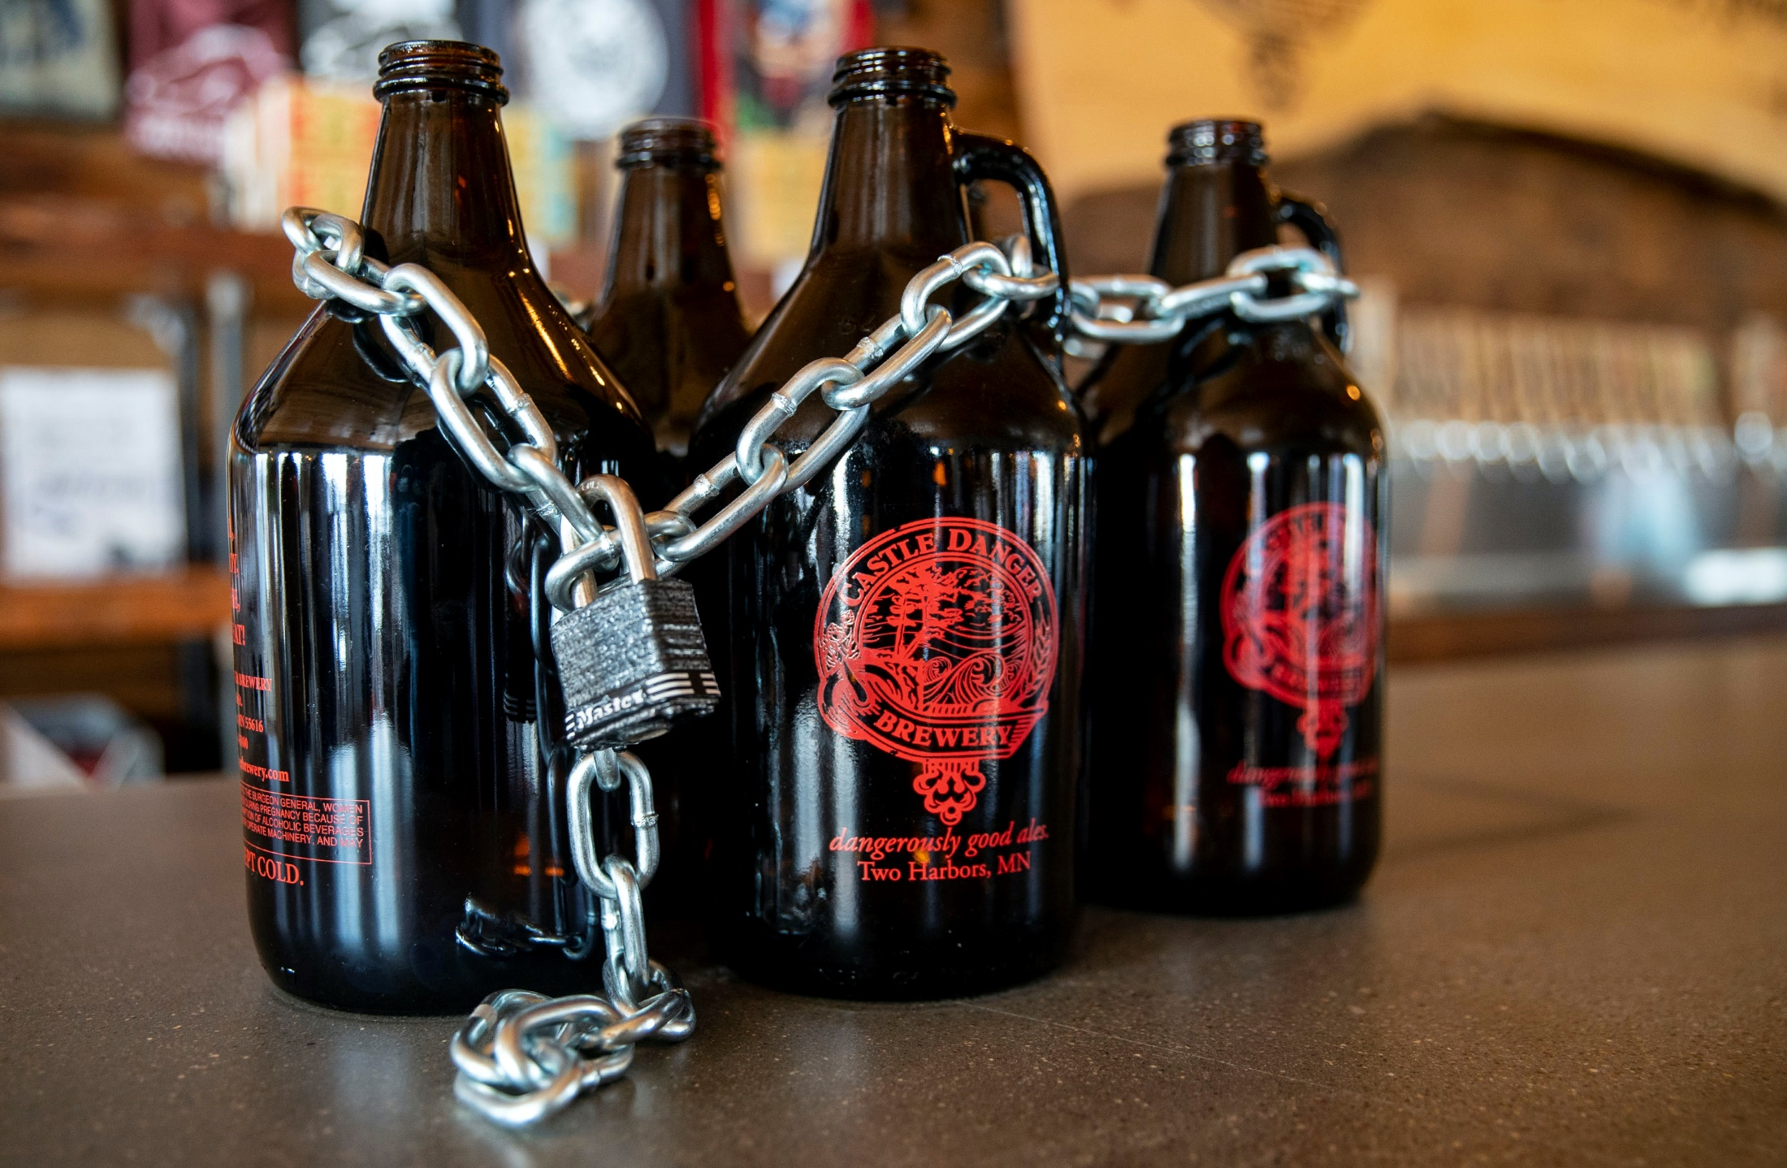

Slide 54
Growlers Minn. Stat. 340A.28, subd. 2
Growler sale cap increased to allow sales by brewers of up to 150,000 barrels of malt liquor
Castle Danger
Lift Bridge
Up from 20,000 barrels per year

Slide 55
Thank you

